Slide 1
Gitflow
Code/Astro 2023

Slide 2
By the end of this lesson, you will be able to:
Create multiple branches within a git repository
Make a pull request from one branch into another
Describe the basic git workflow (”gitflow”)

Slide 3
Why do we Need Gitflow?
When you’re working on big projects, many people are committing at once. Source control allows people to edit the same code base at the same time, using different branches.

Slide 4
Gitflow is a way of using Git and GitHub
Allows for multi-user development and testing
“Protects” the main code
Easy to go back to a stable point if something breaks
Work is performed in parallel on one or more feature branches.

Slide 5
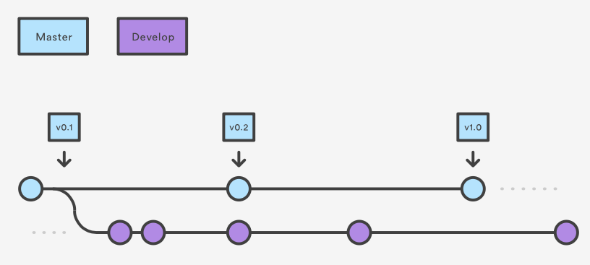
How It Works
1: Make a development branch off main
Main

Slide 6
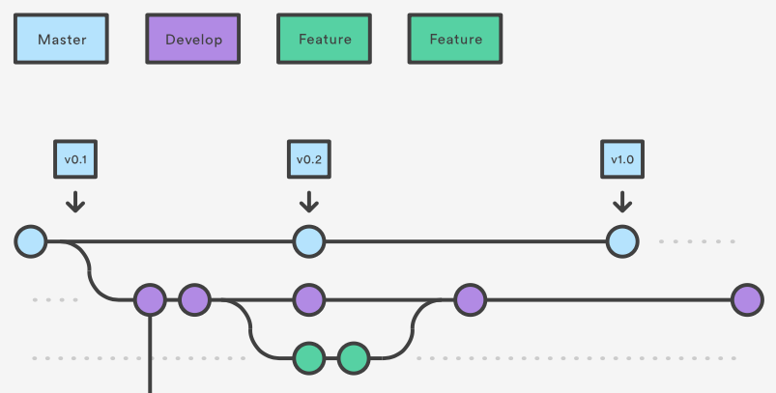
2. Create a feature branch from develop
Main

Slide 7
3. Merge into Develop
Main
Pull Request # 1

Slide 8
4. Merge into main
Main
Pull Request # 2
Pull Request # 1

Slide 9
DEMO!

Slide 10
Summary of process to add a feature
Pull latest code from develop branch.
Create feature branch from develop branch.
Make your changes, stage, commit, then push to GitHub.
Submit pull request on GitHub & merge into develop.
Repeat until enough features have been merged into develop, then make a pull request from develop -> main.

Slide 11
Git Commands
> git checkout –b <new_branch> <orig_branch>
Make a new branch off of <orig_branch> (default: main)
> git checkout <branch>
Switch to desired branch
> git status
Compare local and remote repo, also reports what branch you are currently on
There are a lot of “Git Cheatsheets” online if you want a summary of more commands!

Slide 12
Extra Slides

Slide 13


How Git Works (two analogies):
Analogy stolen from: https://www.freecodecamp.org/news/git-the-laymans-guide-to-understanding-the-core-concepts/
Commits are points in the code you can revisit. Commiting your code is like creating a time capsule.
The process of commiting your code is like the process of making a scrapbook.
Take pictures.
= Make changes to code.
2. Lay them out in a scrapbook.
= Stage the changes.
3. Glue them down.
= Commit the changes.

Slide 14
Class-sourced Vocabulary List
Git: version control system (mercurial)
GitHub: one choice for remote host for source-control projects (also see Gitlab/bitbucket
source control: act of keeping track of history of code
repo (short for “repository”): version-controlled project, keeps track of changes
pull request: way to notify developers of particular changes, and stages the changes in one branch to be pulled into another
commit: a change that adds a new “note” to current branch, like an object that holds iformatio about who made commit, changes involved
branch: way to add new feature to code, might have changes added relative to main/other branchs
clone: local repo copy linked to remote
Code/Astro vocab list: https://docs.google.com/document/d/1HuzcZbUOdDht9Q2Y5RB7d7THucwVZrZAPkskCw9u9XE/edit?usp=sharing
Notes:
on zoom: use stack.
IRL: raise hand.
Alternate btwn zoom & irl

Slide 15
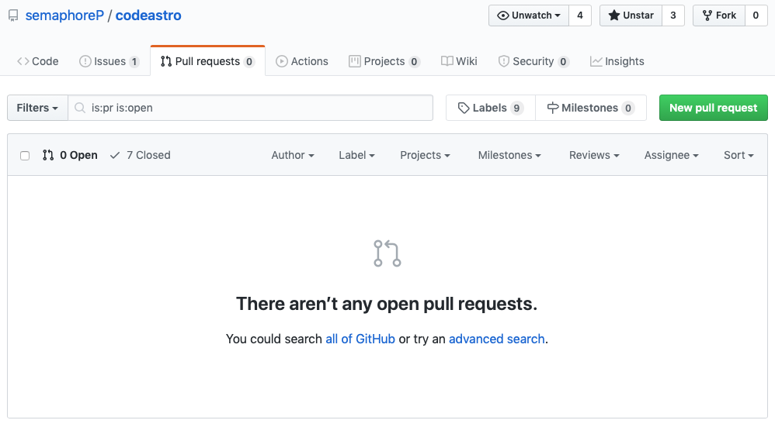
Feature done: Pull Request

Slide 16
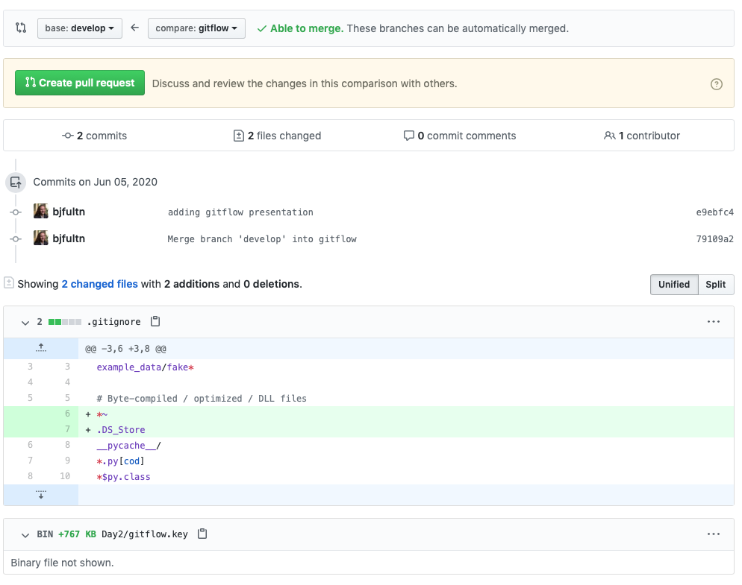
Feature done: Pull Request
Differences between your feature branch and develop will be highlighted
Be descriptive with your changes
Usually an admin or senior developer will review and merge into develop after approval
Automated checks may also run
Delete feature branch after merge

Slide 17
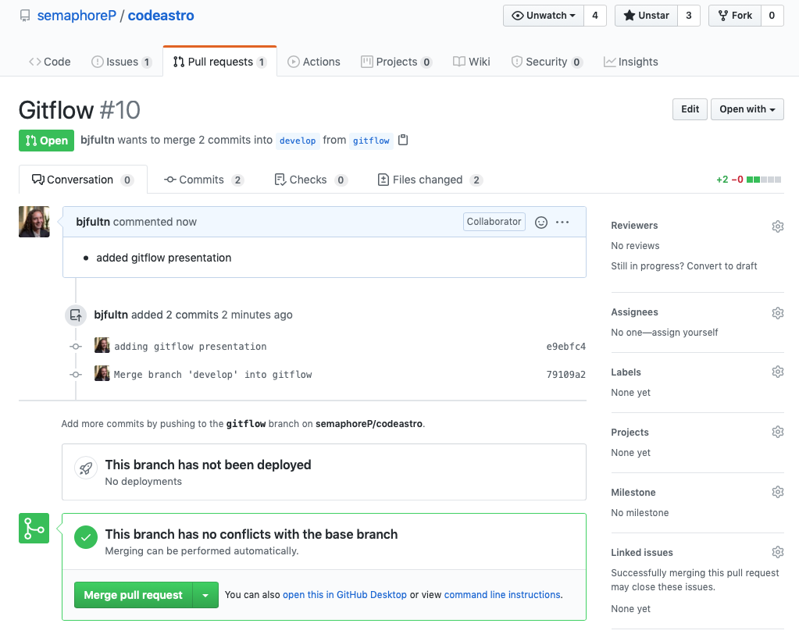
Feature done: Pull Request
Differences between your feature branch and develop will be highlighted
Be descriptive with your changes
Usually an admin or senior developer will review and merge into develop after approval
Automated checks may also run
Delete feature branch after merge

